Slide 1
Firewalls and Firewall Utilities in Linux (iptables)
Bryan Vanek
10/5/16
Cyber Dawgs Presentation

Slide 2
Presentation Objectives
To understand exactly what a firewall is, and why it’s important in the field of Cyber Security.
To understand how ports work, and to go over some important port numbers to keep in mind when configuring any firewall.
To explore the iptables firewall configuration utility in Linux.
Learn the differences between Input, Output, and Forwarding
Learn the differences between Accept, Drop, and Reject
Learn how to write policy chains

Slide 3



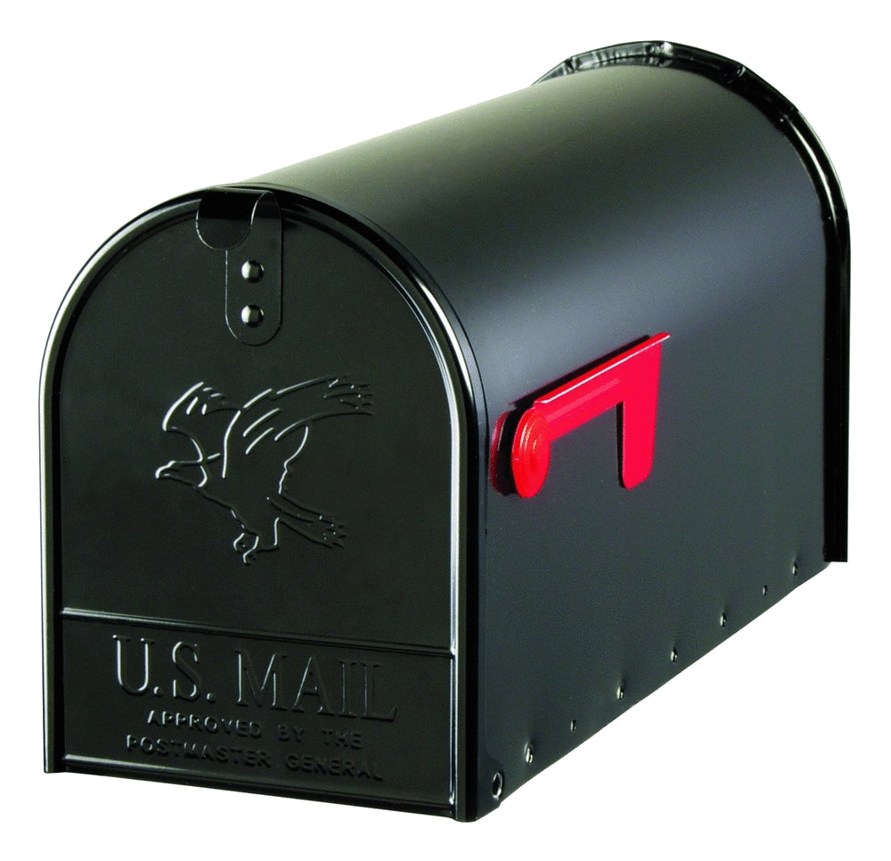



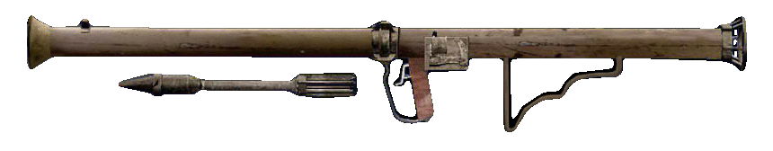
So…What’s a Firewall?

Slide 4
More formally speaking, a firewall is…
At its core, it’s a system designed to prevent unauthorized to or from a private network.
Firewalls can be implemented via hardware OR software
Hardware: security appliances, physically turning ports on/off.
Examples: firewalls built into routers, Cisco/Juniper PoE services
Much better for larger scale configurations
Software: Installed on a computer and takes care of port forwarding/network trafficking.
Examples: Windows Firewall, firewalld, iptables
Better for smaller organizations or individuals (ESPECIALLY for people who move around)

Slide 5
Different Types of Firewalls
Packet Filtering: examining each incoming packet and decide whether or not to allow it in.
Each packet has a header that identifies what kind of packet it is. Written rules will then determine what we do with that piece of data.
This is what we’re going to learn how to do today!
Web Application Firewall: Ways that browsers handle HTTP (averts attackes that SSL would catch)
Using a Proxy Server: Hiding a network address and connect through another means.
You can set up a proxy yourself for the lab today!
Circuit Gateway: Once a connection is made, no need to check those packets. Relies on the three-way handshake (TCP) or connectionless (UDP).

Slide 6
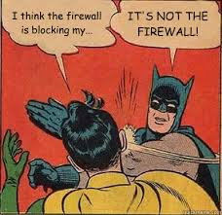
Why are Firewalls Important?
Prevents any kind of intrusion on the network
As explained by Alex last time, there are MANY ways people can get in
Piggyback worms, Trojans, root kits (AHH) and even get root access
Can also keep those who aren’t as aware at bay
Prevent users from launching Ping, make them log in via one method.
NOTE: This is only the first line of defense!

Slide 7


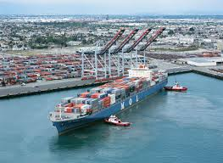

So…what’s a port?
HA. HILARIOUS.

Slide 8
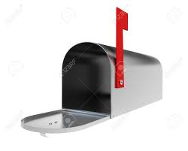
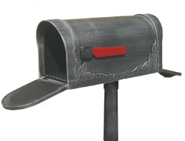


I like to think about it being like a mailbox…
…and each one has four states…
Two-way opening
Only receive
Only give
Completely blocked

Slide 9


So as you can see, it’s not…
…HARD TO PORT!!!

Slide 10
Now then, let’s get into the nitty gritty…
A port is the means with which a computer ‘listens’ for different kinds of network traffic.
Each port is literally only a two way tunnel
Ports are identified by Port numbers, ranging from 0 to 65535
Why that number? Headers in a packet!
Ports 0-1023: Well-known or System Ports. Lots of important ports here.
Ports 1024-49151: Registered Ports. Registered services use these. (Openfire!)
Ports 49152-65535: Ephemeral Ports. Experimental or private services.
When configuring firewalls, it’s usually a good idea to know these numbers!
On to some important ports…

Slide 11
ImPORTant Ports
FTP: File Transfer Protocol – Transfers files between a client and a server.
Port number 20. Used in a lot of older systems. Also used by Firezilla.
VERY INSECURE. Doesn’t do encryption; sends files over plain text.
SFTP: FTP over SSH (port 21). More secure.
SSH: Secure Shell – Unix based command system interface.
Port number 22. Helpful with server control. You use this to get into GL!
A good option for remote login; commands, files, and passwords are encrypted. Also does authentication.
Not perfect; vulnerabilities have been found!
Telnet – Like SSH, but has NO security implementations. (Port 23)
IF SOMEONE EVER USES THIS, SLAP THEM AND MAKE THEM USE SSH.

Slide 12
Important Ports (Cont.)
SMTP: Simple Mail Transfer Protocol – delivers email
Port 25. Used by a lot of common email clients (Outlook Express!)
Needed for email servers; used in tandem with other protocols
POP3 (Port 110) and IMAP (Port 143) handle delivery.
DNS: Domain Name Servers – The way computers resolve host names
Port 53. Can be thought of as a phone book!
Critical to keep up for web servers
HAS VULNERABILITIES. Namely cache poisoning (uses fake address to divert)
DHCP: Dynamic Host Configuration Protocol – automatic IP provision
Port 67. Crucial for IP management/web servers.

Slide 13

Important Ports (Cont.)
HTTP: Hypertext Transfer Protocol – Connects you to the web
Port 80. Transfers files and pages over the web. HTML then formats
If you block this, you can’t connect to certain web pages!!
However, HTTP by itself is insecure! Man-in-the-middle attacks can see stuff!
HTTPS: HTTP over SSL /TLS (Secure Socket Layer/Transport Layer Security)
Port 443. Requires authentication; encrypts and decrypts pages
Not perfect (HEARTBLEED), but still very secure! Locked down as of now
Web Caching: sometimes called HTTP Proxy
Port 8080. Allows you to store web pages!
Necessary to have on if you ever want to utilize proxies

Slide 14
Need to talk about one more thing…
TCP vs UDP: Transmission Control Protocol vs User Datagram Protocol
Reliability vs Speed; Connection oriented vs connectionless. Both used by IP.
What kinds of protocols do you think belong in one of these? Applications?
ICMP: Internet Control Message Protocol
Used by network devices for reporting errors.
Tools: ping, traceroute, echo
Unless you’re the admin, DISABLE THESE. Ping = bad people knowing when you’re server is up (or down).
Wanna learn more about port numbers?!?
http://packetlife.net/media/library/23/common_ports.pdf

Slide 15

NOW IT’S TIME FOR THE FUN STUFF!
(or at least I think it’s fun…)

Slide 16


What is iptables?

Slide 17
Iptables: Software Firewall
Can be thought of as a flexible firewall utility for Linux operating systems.
Unlike something like Windows Firewall, you can configure everything yourself!
Uses Policy Chains in order to perform Packet Filtering.
Usually comes pre-installed on a lot of Linux distros. Some, however, are migrating…
Firewalld is another, more modern version of iptables.
Uses a lot of the same commands as iptables; provides a little more flexibility.
More commonly found in Fedora (Fedora 21 and higher)
Important to understand iptables before you look at firewalld
GUI Alternatives are also available (Turtle, Firestarter), but being able to work with the command line is an essential when working in Linux!

Slide 18




The Three Chains: IFO! The Three States: ADR!
DEMO TIME!!!

Slide 19

Lab Time!!!
Your Mission, should you choose to accept it:
Finish installing HTTPD, Openfire, and enabling/migrating to IPTables
Create tcp catch-alls for your input and output chains.
Enable HTTP and HTTPS
Be able to access your HTTPD server (you need to do more here with output catch-all on!)
ONLY access Openfire through your proxy.
Specify this rule for both interfaces (what should we take away?)
Enable SSH
Be able to log into GL (remember: two-way connection!)
YOU HAVE TO SPECIFY THE INTERFACE; NO BLANKET INTERFACE.
Enable mailing protocols and name resolution (remember the ports?!)
(This is redundant, but…) Block two very insecure protocols (again, remember the ports?)
Prevent your server from being able to access Facebook and Yahoo.
Prevent USERS from performing traceroute, netstat, or ping (SINGLE RULE)
Make rules persistent upon logoff (SNAPSHOT before you try this!!)
EXTRA CREDIT: Find a way to prevent a DoS attack

Slide 20
Iptables cheat sheet
iptables –L: Lists the current rules set in iptables
--line-numbers: lists line numbers
iptables –F: Clears the current ruleset
iptables –P [chain] [policy]: Sets the default policy of a chain.
Iptables –D [chain] [line number]: Delete a single rule on specified line number.
Chain writing options
-A [chain]: Appends a chain to end of the list of rules
-I [chain]: Inserts a chain at front of the list of rules
-j [policy]: ‘jumps’ or activates a particular policy
-p [ip protocol]: specifies rule to protocol (ex. tcp, icmp)
--destination-port [port #]: destination port # (80, 22)
--source-port [port #]: specifies source port # (same as above)
-i [interface]: specifies an interface for INPUT. (Use –o for output).
Iptables-save > [iptables file location]: script that saves your rules upon logoff.
Policies |  | Chains
ACCEPT | Allow in/out | INPUT | Incoming connects
DROP | Don’t allow (no error) | OUTPUT | Outgoing connects
REJECT | Don’t allow (w/ error) | FORWARD | Routing + Proxies

Slide 21

THANKS, GUYS!!!
Hope you learned something today!
Questions? You can email me below!
bvanek1@umbc.edu

